Slide 1
Azure Data Factory Capstone - Covid Use Case

Slide 2
Project objective:
How to build a real-world data pipeline in Azure Data Factory (ADF) to analyze the covid trend across the regions using Azure cloud data services.
How to ingest data from flat files into Azure Data Lake Gen2 and Azure Synapse using Azure Data Factory (ADF)
How to transform data using Data Flows in Azure Data Factory (ADF) and load into Azure Synapse.

Slide 3
Project overall Architecture Diagram

Slide 4
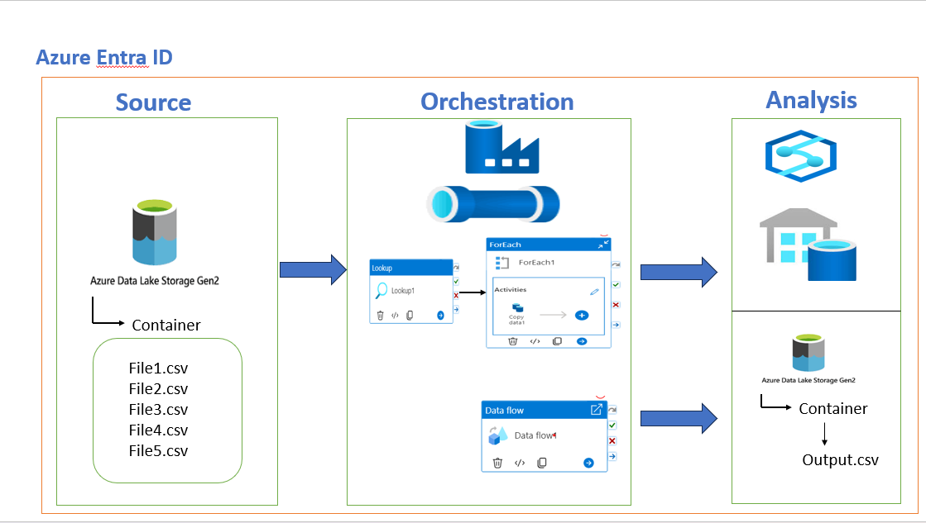

Slide 5





Linked service
Storage account to data factory
Linked service synapse to data factory
Data factory
Azure synapse
Storage account
Linked service data lake to data factory
Data lake

Slide 6
Project Requirement 1 Overview through architecture

Slide 7
Linked service
Storage account to data factory
Linked service synapse to data factory
Storage account
Data factory
synapse
Ingesting process taken place in data factory by taking raw data from storage account(data lake) to relation database by creating tables in synapse(data warehouse)

Slide 8
Pipeline architecture created in data factory

Slide 9




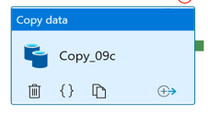
Pipeline
Table 1
CSV Dataset
Table Dataset
Table 2
CSV Dataset
Table Dataset
Table 3
Parameters Dataset
CSV Dataset
Table Dataset
Table 4
CSV Dataset
Table Dataset
Table 5
CSV Dataset
Table Dataset
Dynamically loading data from each csv file into each SQL table by using one copy activity and parameters Dataset

Slide 10
Project Requirement 2 Overview through architecture

Slide 11
Linked service
Storage account to data factory
Storage account
Data factory
Linked service data lake to data factory
Data lake
Data Transformation in data factory by taking Raw data from Storage account(data lake) modifying as per over requirements given in project and storing that file in storage account(data lake)

Slide 12
Transformation on data by using Data flow in Data factory

Slide 13
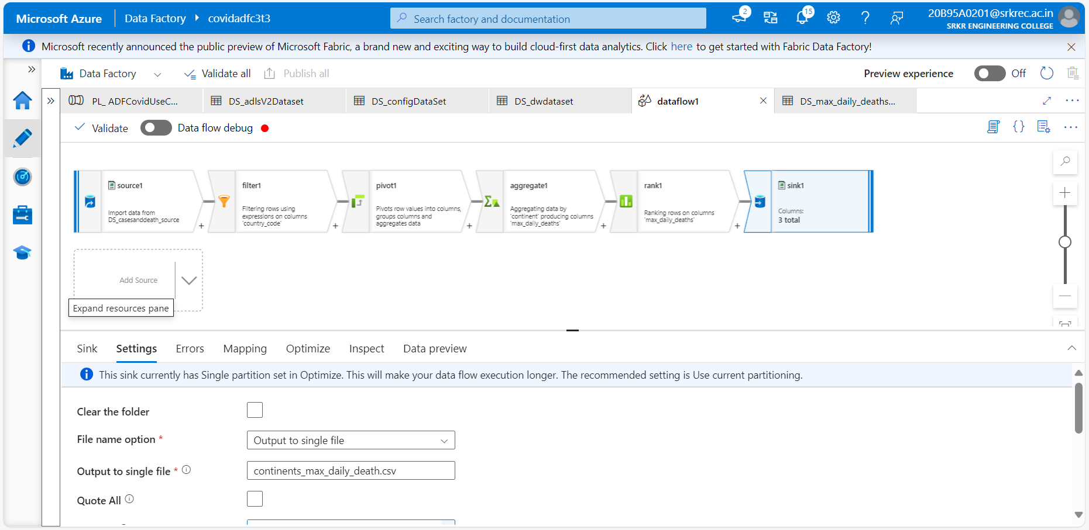

Slide 14
Data Verification:
Query 1:
Query 2 :
Write a Query to check the confirmed cases in India in
March’2020 and verify with source data in excel?
select * from AllOverDeaths
where [country]='India' and
[indicator]='confirmed cases' and
MONTH ([date])='3' and
YEAR ([date])='2020';
Write a query to show country wise confirmed
case in 2020?
select [country],[indicator],[daily_count],[date] from AllOverDeaths
where [indicator]='confirmed cases' AND
YEAR ([date])='2020'
group by [country],[indicator],[daily_count],[date]
order by [country] asc,[date] asc;

Slide 15
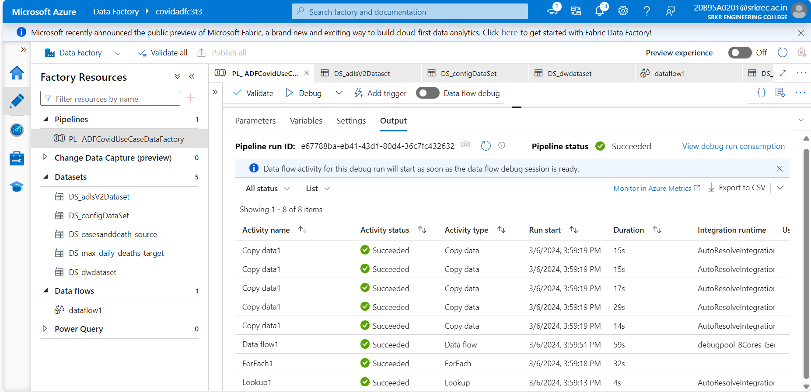
Pipeline output:

Slide 16
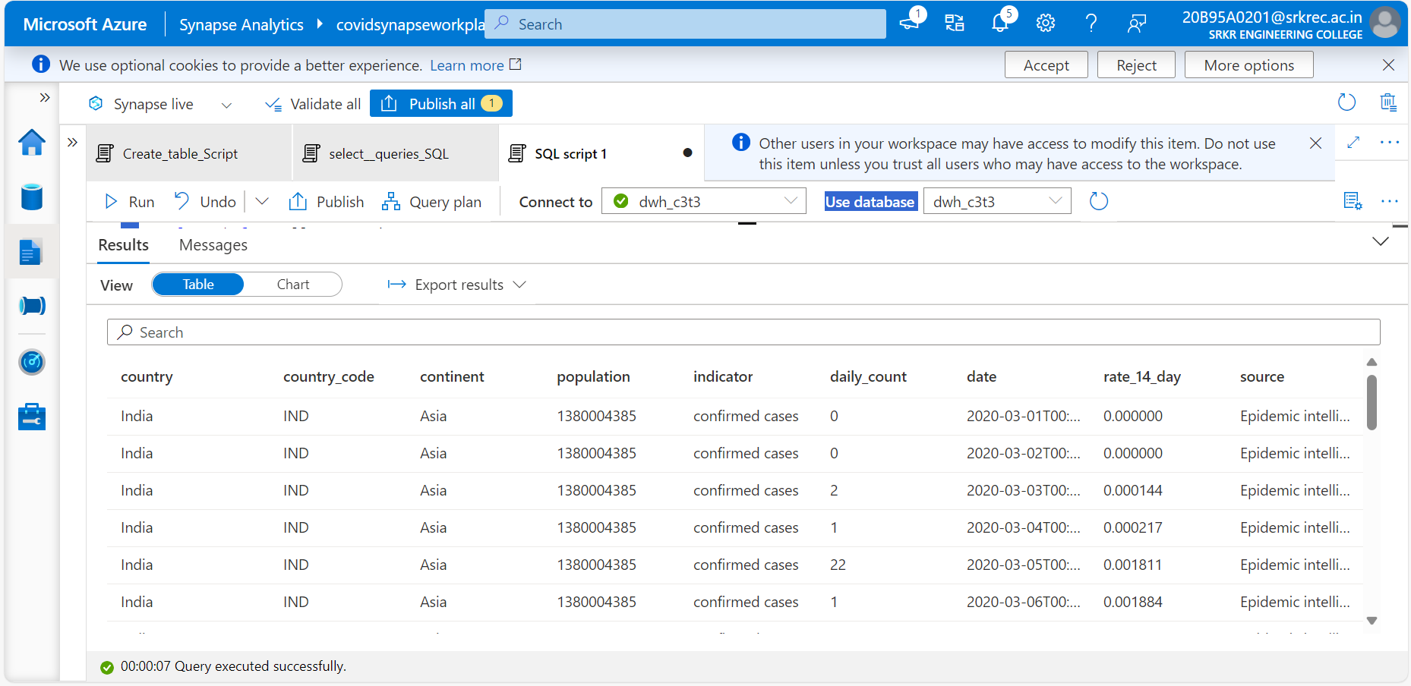
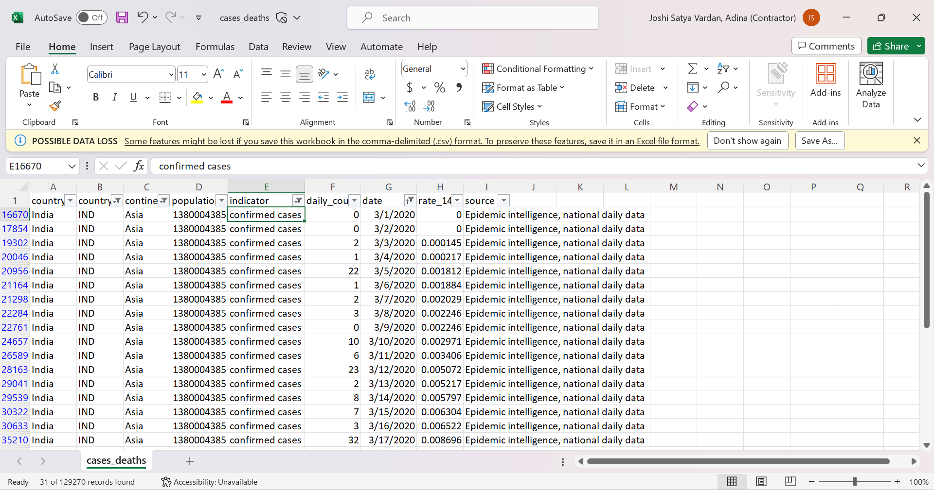
Query 1:

Slide 17
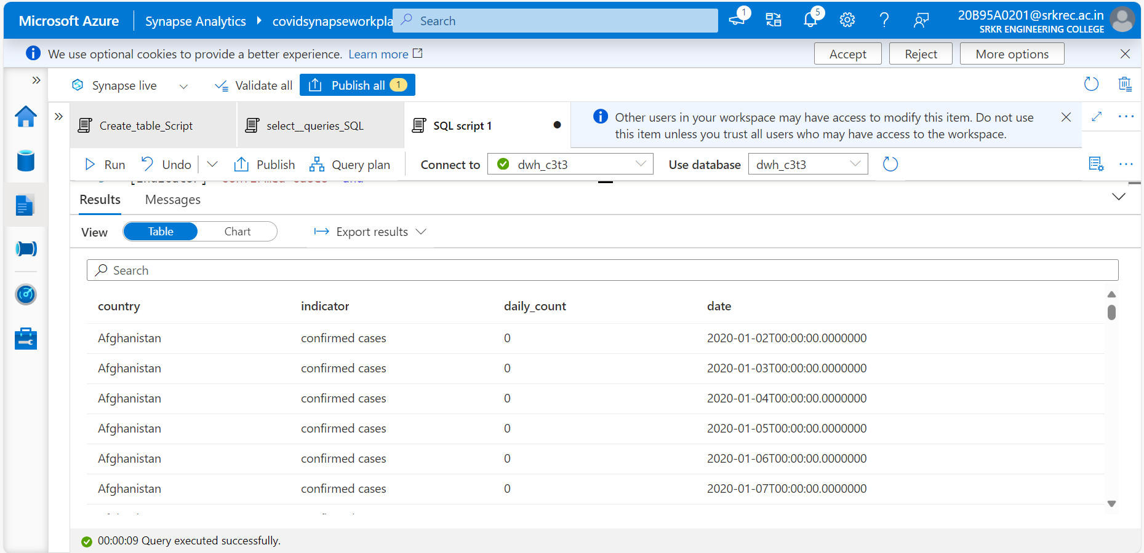
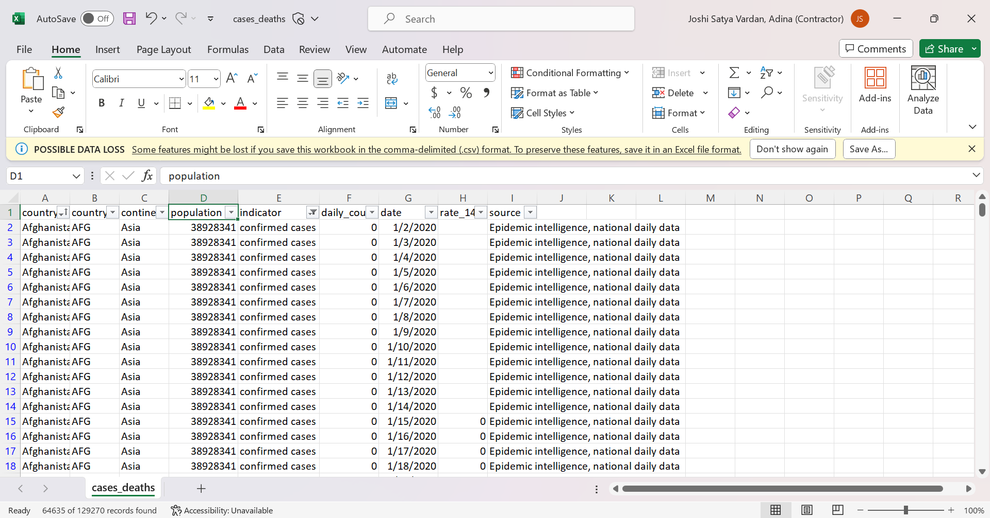
Query 2:

Slide 18
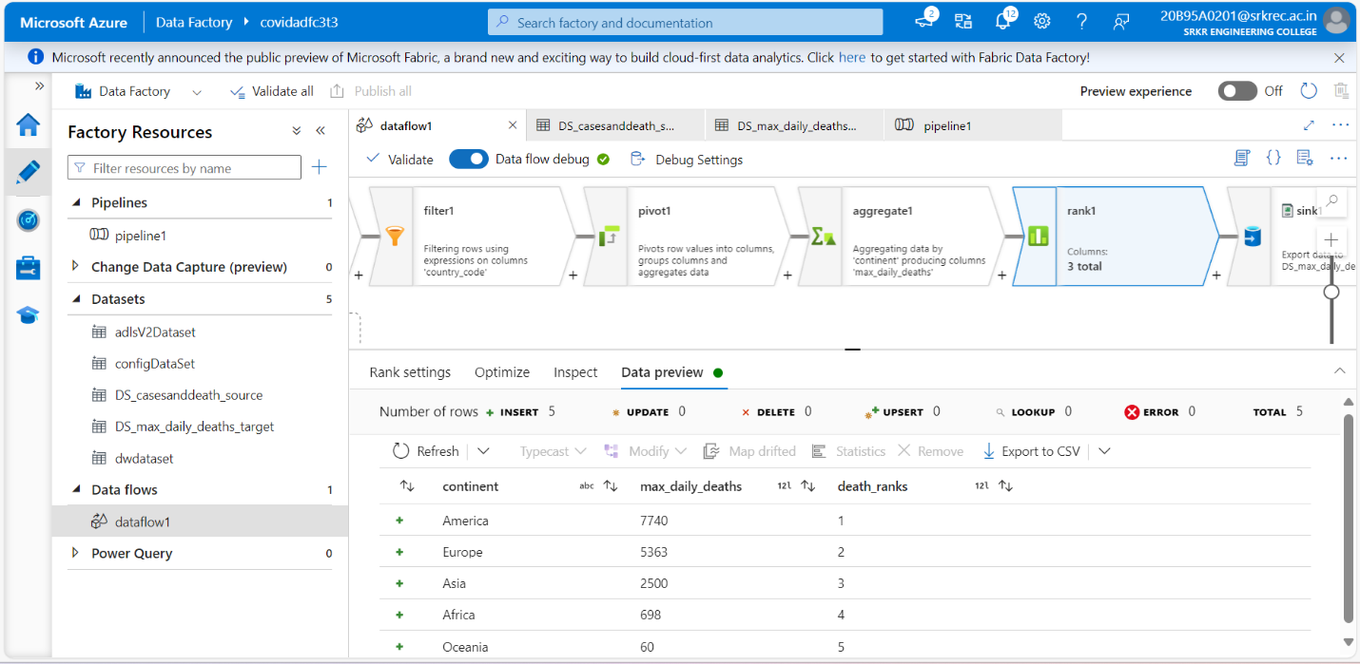
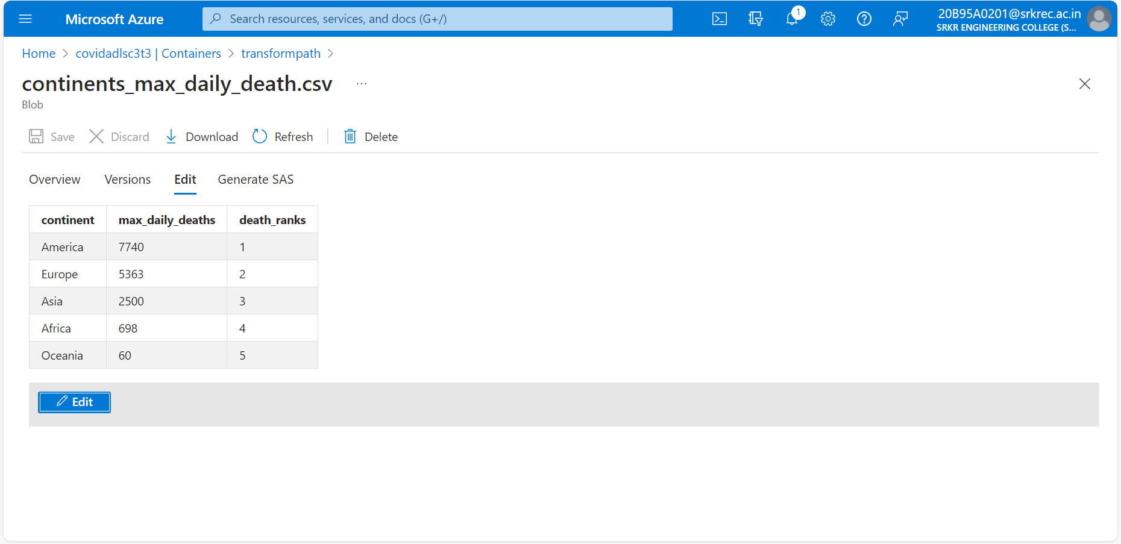
Data flow Output:

